Slide 1




Other Types in OOP
Enumerations, Structures, Generic Classes, Attributes
SoftUni Team
Technical Trainers
Software University
http://softuni.bg

Slide 2


Table of Contents
Enumerations
Structures
Dynamic
Generic Classes
Attributes
Cup<T>
[Description("Adds...")]

Slide 3

Enumerations
Defining and Using Enumerated Types

Slide 4
Enumerations in C#
Enumerations are types that hold a value from a fixed set of named constants, declared by the enum keyword in C#
public enum DayOfWeek
{
Mon, Tue, Wed, Thu, Fri, Sat, Sun
}
public class EnumExample
{
public static void Main()
{
DayOfWeek day = DayOfWeek.Wed;
Console.WriteLine(day); // Wed
}
}

Slide 5
Enumerations – Example
public enum CoffeeSize
{
Small = 100, Normal = 150, Double = 300
}
public class Coffee
{
private CoffeeSize size;
public Coffee(CoffeeSize size)
{
this.size = size;
}
public CoffeeSize Size
{
get { return this.size; }
}
} (the example continues)

Slide 6
Enumerations – Example (2)
public class CoffeeMachine
{
static void Main()
{
Coffee normalCoffee = new Coffee(CoffeeSize.Normal);
Coffee doubleCoffee = new Coffee(CoffeeSize.Double);
Console.WriteLine("The {0} coffee is {1} ml.",
normalCoffee.Size, (int)normalCoffee.Size);
// The Normal coffee is 150 ml.
Console.WriteLine("The {0} coffee is {1} ml.",
doubleCoffee.Size, (int)doubleCoffee.Size);
// The Double coffee is 300 ml.
}
}

Slide 7

Enumerations
Live Demo

Slide 8
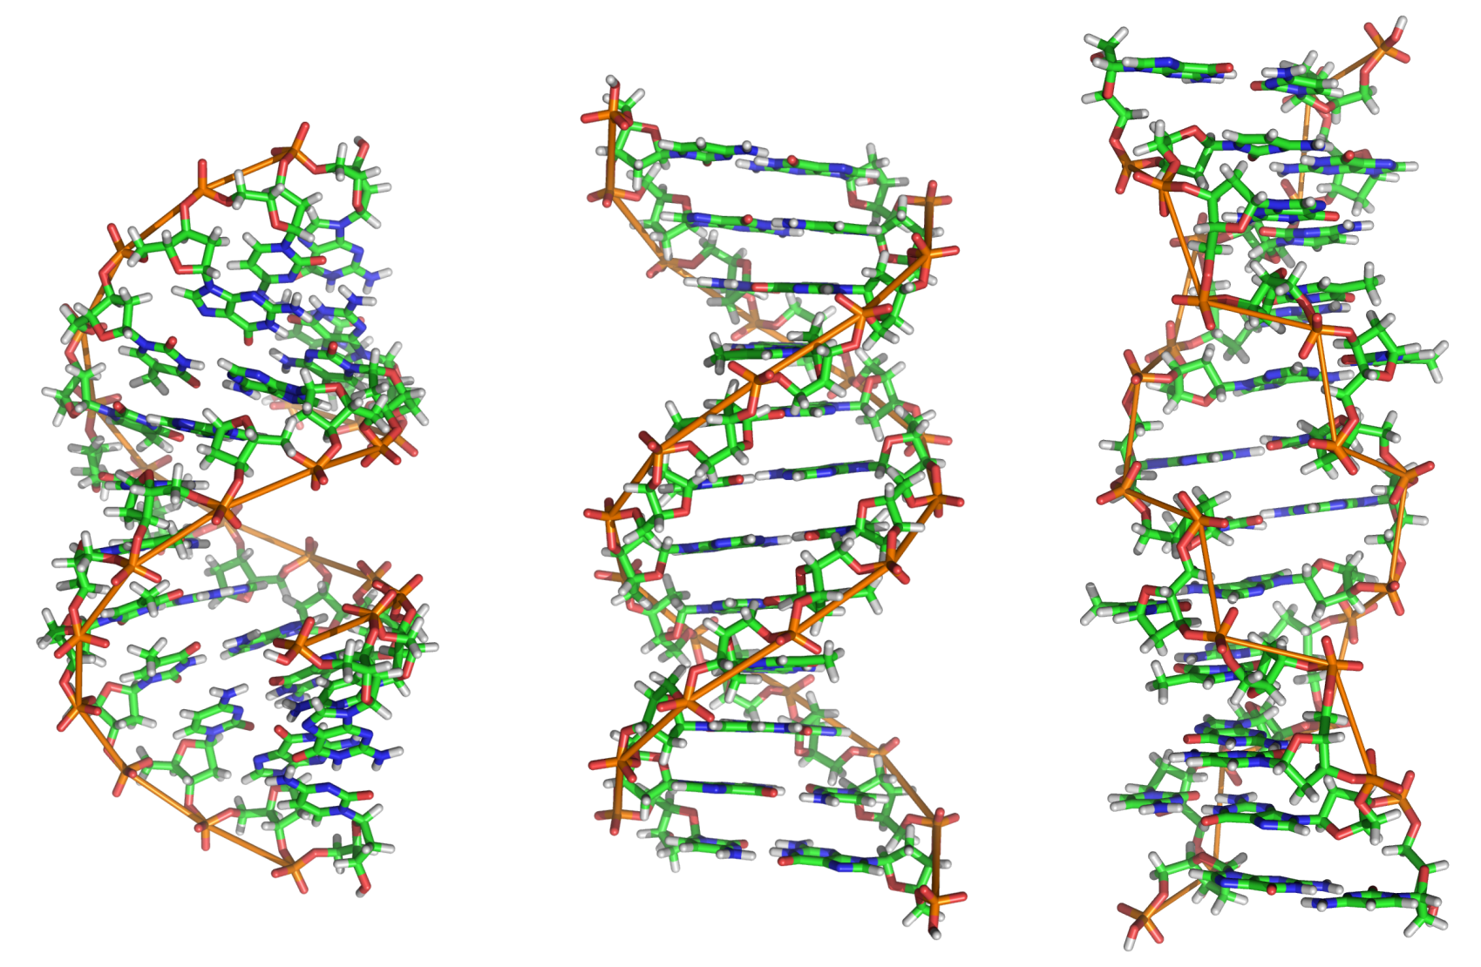
C# Structures

Slide 9
C# Structures
What is a structure in C#?
A value data type (behaves like a primitive type)
Examples of structures: int, double, DateTime
Classes are reference types
Declared by the keyword struct
Structures have fields, properties, constructors, methods, etc. (just like classes)
Always have a parameterless constructor
It cannot be removed
Mostly used to store data (a bunch of fields)

Slide 10
C# Structures – Example
struct Point
{
public int X { get; set; }
public int Y { get; set; }
}
struct Color
{
public byte RedValue { get; set; }
public byte GreenValue { get; set; }
public byte BlueValue { get; set; }
}
enum Edges { Straight, Rounded }
(example continues)

Slide 11
C# Structures – Example (2)
struct Square
{
public Point Location { get; set; }
public int Size { get; set; }
public Color SurfaceColor { get; set; }
public Color BorderColor { get; set; }
public Edges Edges { get; set; }
public Square(Point location, int size,
Color surfaceColor, Color borderColor,
Edges edges) : this()
{
this.Location = location;
this.Size = size;
this.SurfaceColor = surfaceColor;
this.BorderColor = borderColor;
this.Edges = edges;
}
}

Slide 12
Structures vs Classes
Struct Color
Allocated in the stack
color holds the value of the variable
Instance of Class Color
Allocated in the heap
color holds an address (4 or 8-byte) to a memory area in the heap, where the color object is stored (header + data)
01 | 02 | 03
Color color = new Color(1, 2, 3);
3 bytes
f0 | 5a | 03 | 72 | 01 | 02 | 03
Color color = new Color(1, 2, 3);
3 bytes
4 header bytes

Slide 13
When to Use struct
Consider defining a struct instead of a class if:
Instances of the type are small and commonly short-lived
Avoid defining a struct unless the type has all of the following characteristics:
It logically represents a single value, similar to primitive types (int, double, etc.)
It has an instance size under 16 bytes
It is immutable
It will not have to be boxed frequently

Slide 14
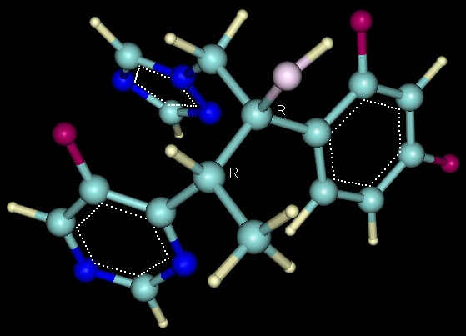

C# Structures
Live Demo

Slide 15


Dynamic Type
dynamic

Slide 16
Dynamic Type
The dynamic type is:
Defined with the dynamic keyword
Can hold anything (numbers, strings, objects, functions, etc.)
Evaluated at runtime (when invoked)
Examples:
dynamic dyn = 5;
dyn = "Some text";
dyn = new Student();
dyn = new[] { 5, 8, 10 };
dyn = (Func<string, double>)double.Parse;

Slide 17
Dynamic vs. Object
In C# we have object and dynamic data types
C# objects (System.Object instances)
Can hold any C# data, e.g. numbers, strings, arrays, methods
Strongly typed, need casting: int value = (int) obj;
C# dynamic objects
Can hold any C# data, e.g. numbers, strings, arrays, methods
Evaluated at runtime, i.e. operations are always valid, but can fail at runtime

Slide 18
Using Dynamic Types
Dynamic objects always compile, but could fail at runtime
dynamic a = 5; // a holds int value
dynamic b = 2.5; // b holds double value
dynamic c = 5 + 2.5; // evaluated to 7.5 (double) at runtime
dynamic h = "hello";
dynamic w = "world";
dynamic str = h + w; // evaluated to string at runtime
dynamic incorrect = str + a; // runtime error!
dynamic x = str / 10; // runtime error!

Slide 19
ExpandoObject
ExpandoObject is a dynamic object
Its members can be dynamically added / removed at runtime
Part of System.Dynamic namespace
dynamic contact = new ExpandoObject();
contact.Name = "Asen";
contact.Age = 29;
contact.IncrementAge = (Action)(() => { contact.Age++; });
contact.IncrementAge();
Console.WriteLine("Hi, I'm {0} and I'm {1} years old.",
contact.Name, contact.Age);

Slide 20

Dynamic Type
Live Demo

Slide 21

Generic Classes
Parameterizing Classes

Slide 22
What are Generics?
Generics allow defining parameterized classes that process data of unknown (generic) type
The class is instantiated (specialized) with different particular types
Example: List<T> → List<int> / List<string> / List<DateTime> / List<Student>
Generics are known as "parameterized types" or "template types"
Similar to the templates in C++
Similar to the generics in Java

Slide 23
Generic Class – Example
T is an unknown type, parameter of the class
public class GenericList<T>
{
public void Add(T element) { … }
}
class GenericListExample
{
static void Main()
{
// Declare a list of type int
GenericList<int> intList =
new GenericList<int>();
// Declare a list of type string
GenericList<string> stringList =
new GenericList<string>();
}
}
T can be used in any method in the class
T can be replaced with int during the instantiation

Slide 24
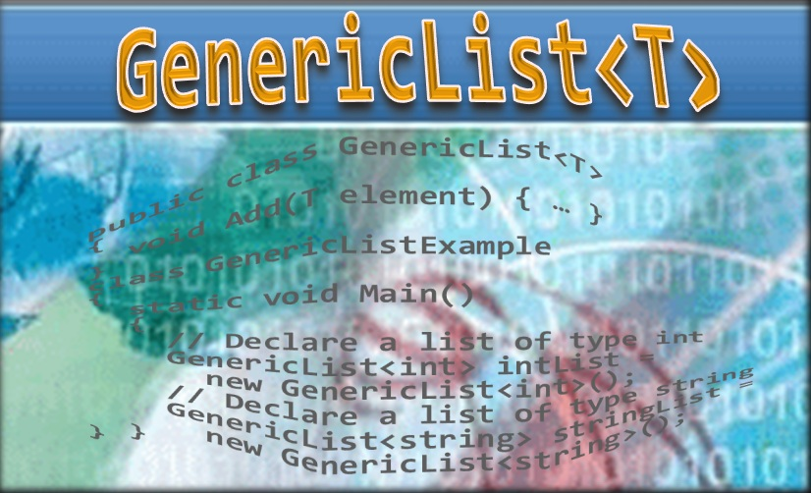
Generic Classes
Live Demo

Slide 25
Generic Methods
Methods can also be generic
Can take generic input and return generic output
public static T[] CreateArray<T>(T value, int count)
{
T[] arr = new T[count];
for (int i = 0; i < count; i++) arr[i] = value;
}
static void Main()
{
string[] strings = CreateArray("hello", 5);
Console.WriteLine(string.Join(", ", strings));
}

Slide 26
Generic Method – Example
public static T Min<T>(T first, T second)
where T : IComparable<T>
{
if (first.CompareTo(second) <= 0)
return first;
else
return second;
}
static void Main()
{
int i = 5;
int j = 7;
int min = Min<int>(i, j);
}

Slide 27

Generic Methods
Live Demo

Slide 28

Exercise in Class

Slide 29
Exercise in Class – CustomList<T>
Define a class CustomList<T> that stores objects of any type and supports the following operations:
Adding/Removing elements
Auto-resize when capacity is reached
Accessing elements by index
IndexOf() method for finding element by value
Min<T>() and Max<T>() methods for finding the smallest/largest element

Slide 30

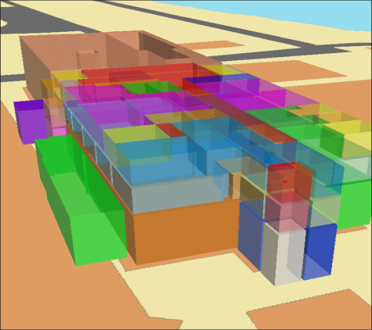
Attributes
Applying Attributes to Code Elements

Slide 31
What are Attributes?
.NET attributes are:
Declarative tags for attaching descriptive information in the declarations in the code
Saved in the assembly at compile time
Objects derived from System.Attribute
Can be accessed at runtime (through reflection) and manipulated by many tools
Developers can define custom attributes

Slide 32
Applying Attributes – Example
Attribute's name is surrounded by square brackets: []
Placed before their target declaration
[Flags] attribute indicates that the enum type can be treated like a set of bit flags
[Flags] // System.FlagsAttribute
public enum FileAccess
{
Read = 1,
Write = 2,
ReadWrite = Read | Write
}

Slide 33
Attributes with Parameters (2)
Attributes can accept parameters for their constructors and public properties
The [DllImport] attribute refers to:
System.Runtime.InteropServices.DllImportAttribute
"user32.dll" is passed to the constructor
"MessageBox" value is assigned to EntryPoint
[DllImport("user32.dll", EntryPoint="MessageBox")]
public static extern int ShowMessageBox(int hWnd,
string text, string caption, int type);
…
ShowMessageBox(0, "Some text", "Some caption", 0);

Slide 34
Set a Target to an Attribute
Attributes can specify their target declaration:
See the Properties/AssemblyInfo.cs file
// target "assembly"
[assembly: AssemblyTitle("Attributes Demo")]
[assembly: AssemblyCompany("DemoSoft")]
[assembly: AssemblyProduct("Enterprise Demo Suite")]
[assembly: AssemblyVersion("2.0.1.37")]
[Serializable] // [type: Serializable]
class TestClass
{
[NonSerialized] // [field: NonSerialized]
private int status;
}

Slide 35
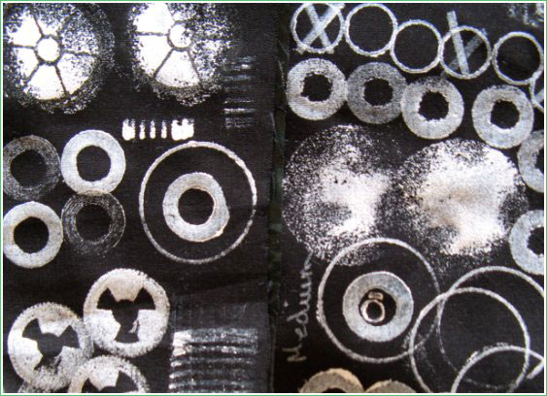


Using Attributes
Live Demo

Slide 36
Custom Attributes
.NET developers can define their own custom attributes
Must inherit the System.Attribute class
Their names must end with "Attribute"
Possible targets must be defined via [AttributeUsage]
Can define constructors with parameters
Can define public fields and properties

Slide 37
Custom Attributes – Example
[AttributeUsage(AttributeTargets.Struct |
AttributeTargets.Class | AttributeTargets.Interface,
AllowMultiple = true)]
public class AuthorAttribute : System.Attribute
{
public string Name { get; private set; }
public AuthorAttribute(string name)
{
this.Name = name;
}
}
// Example continues

Slide 38
Custom Attributes Example (2)
[Author("Svetlin Nakov")]
[Author("Bay Ivan")]
class CustomAttributesDemo
{
static void Main(string[] args)
{
Type type = typeof(CustomAttributesDemo);
object[] allAttributes = type.GetCustomAttributes(false);
foreach (AuthorAttribute attr in allAttributes)
{
Console.WriteLine(
"This class is written by {0}. ", attr.Name);
}
}
}

Slide 39

Defining, Applying and Retrieving Custom Attributes
Live Demo

Slide 40

Summary
Enumerations define a fixed set of constants
E.g. the days of the week
Structures are "value-type" classes
Dynamic type objects can contain everything
Evaluated at runtime
Generics are parameterized classes
Template classes for processing data of unknown (generic) type
Generic methods can accept generic parameter types
Attributes allow adding metadata in classes / types / etc.

Slide 41









OOP – Other Types in OOP
https://softuni.bg/courses/oop/

Slide 42

License
This course (slides, examples, demos, videos, homework, etc.) is licensed under the "Creative Commons Attribution-NonCommercial-ShareAlike 4.0 International" license
Attribution: this work may contain portions from
"Fundamentals of Computer Programming with C#" book by Svetlin Nakov & Co. under CC-BY-SA license
"OOP" course by Telerik Academy under CC-BY-NC-SA license

Slide 43





Free Trainings @ Software University
Software University Foundation – softuni.org
Software University – High-Quality Education, Profession and Job for Software Developers
softuni.bg
Software University @ Facebook
facebook.com/SoftwareUniversity
Software University @ YouTube
youtube.com/SoftwareUniversity
Software University Forums – forum.softuni.bg

